Slide 1

Qualys Demo - 1
Lets take a look at Qualys Demo
Free Qualys tools:
BrowserCheck
SSL
Qualys FreeScan
Vulnerability
OWASP
Patch Tuesday
SCAP

Slide 2
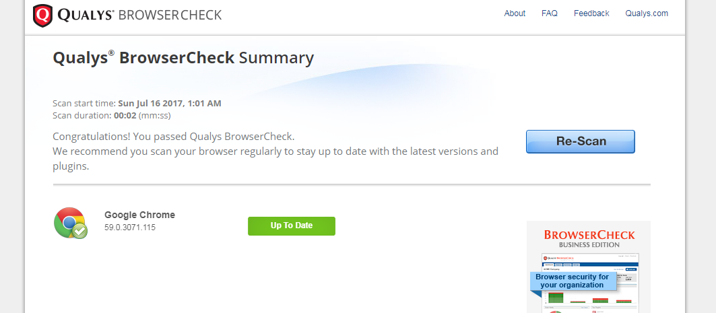
Qualys Demo - 1
QUALYS BROWSER CHECK

Slide 3
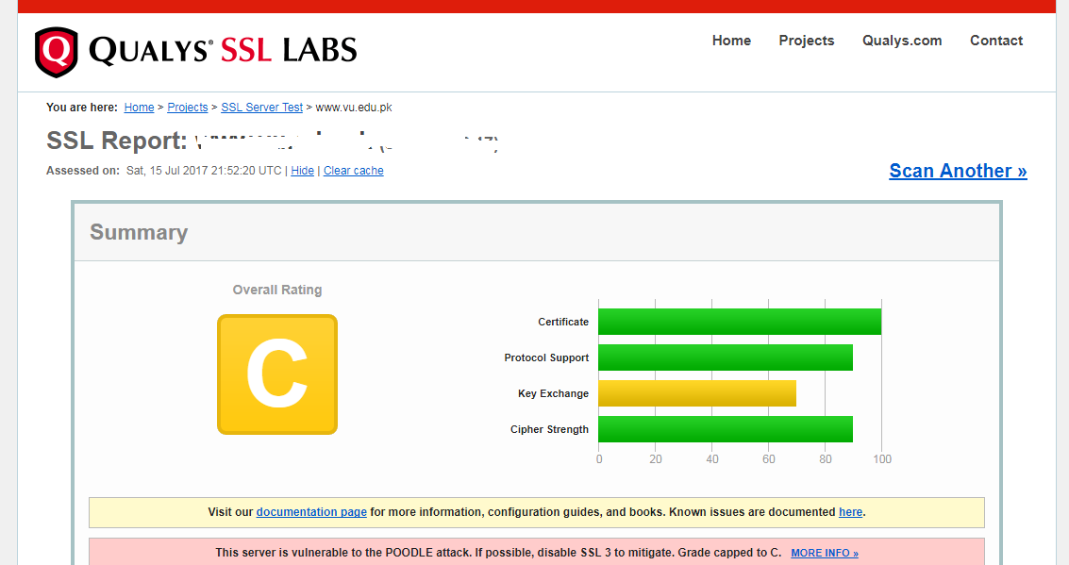
Qualys Demo - 1
SSL LABS REPORT

Slide 4
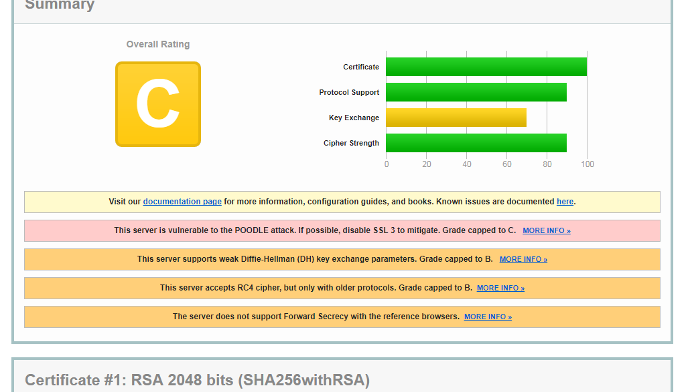
Qualys Demo - 1
SSL LABS REPORT

Slide 5
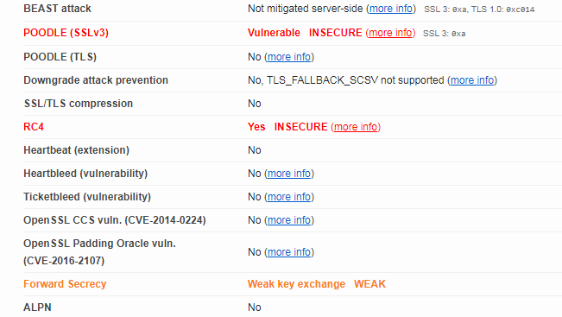
Qualys Demo - 1
PROTOCOL DETAILS

Slide 6
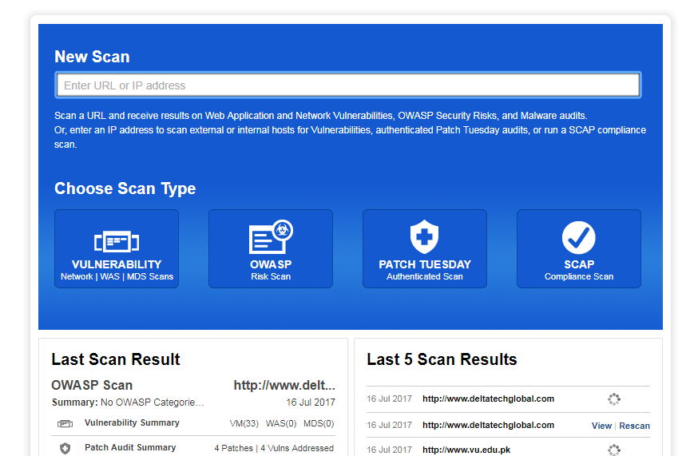
Qualys Demo - 1
QUALYS FREESCAN

Slide 7
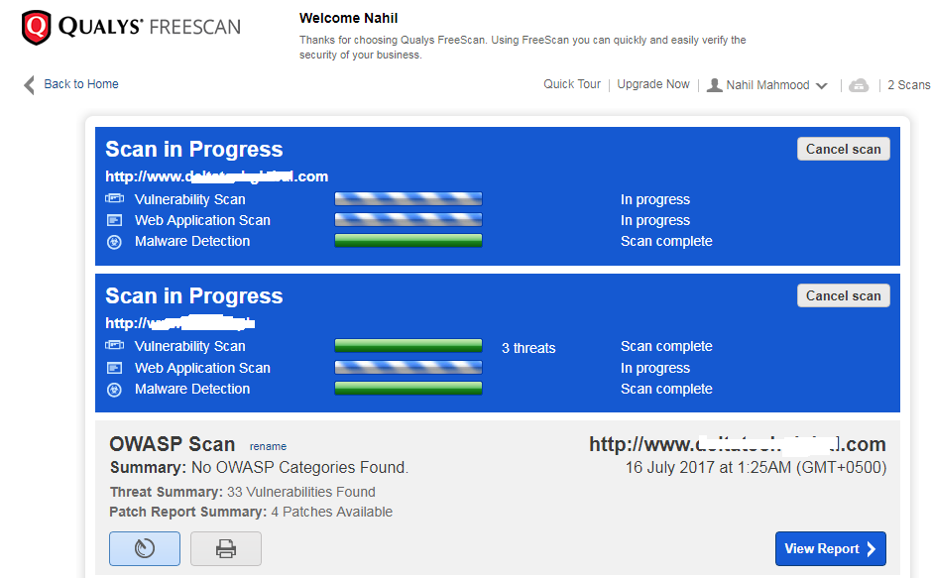
Qualys Demo - 1
QUALYS FREESCAN

Slide 8
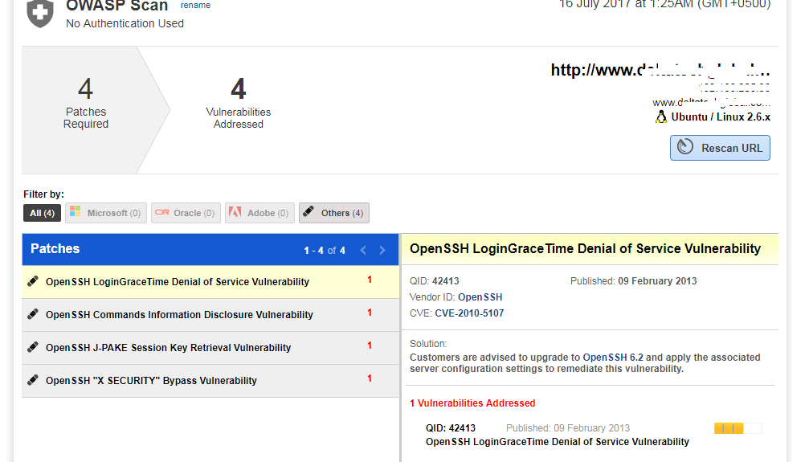
Qualys Demo - 1
OWASP SCAN PATCH REPORT

Slide 9
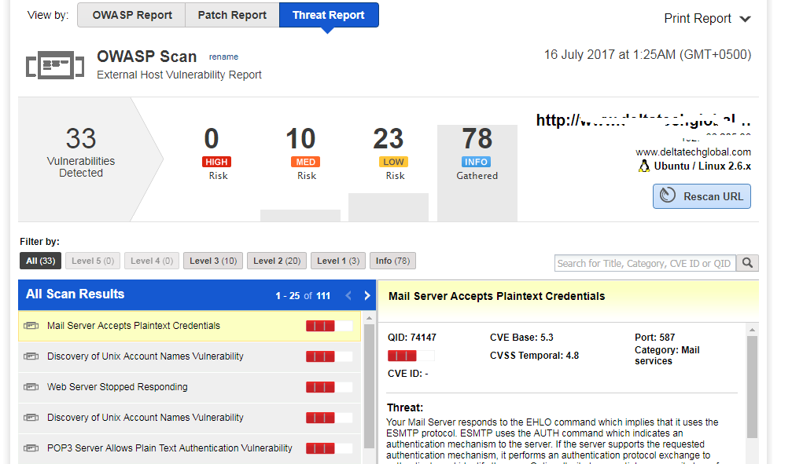
Qualys Demo - 1
THREAT REPORT

Slide 10
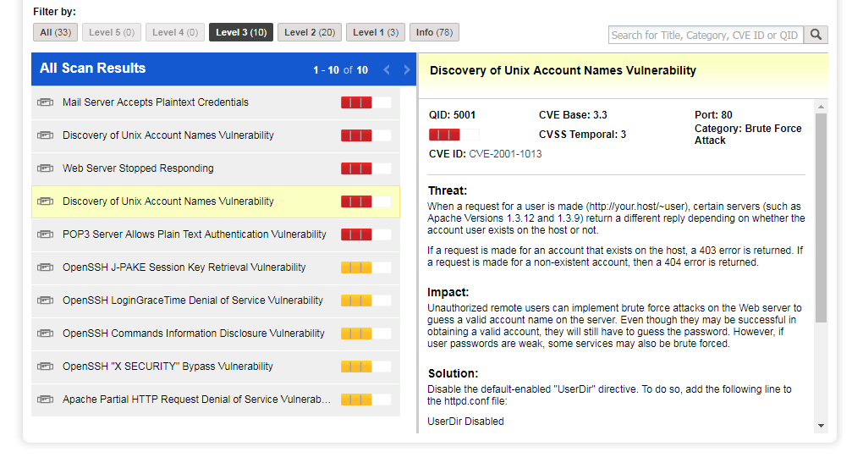
Qualys Demo - 1
THREAT REPORT

Slide 11
Qualys Demo - 1
Qualys is a powerful cloud-based vulnerability management tool
Several online free tools
Advanced web application security testing
END

